Slide 1


Summer internship 2024
SW Dev tools
« Online extractor » project context
Directed by : Benaziza Aya

Slide 2







Introduction
Plan
Environment : Python & Github
STM32 Cube Firmware package
STM32 IDEs
Online Extractor
Project objective

Slide 3


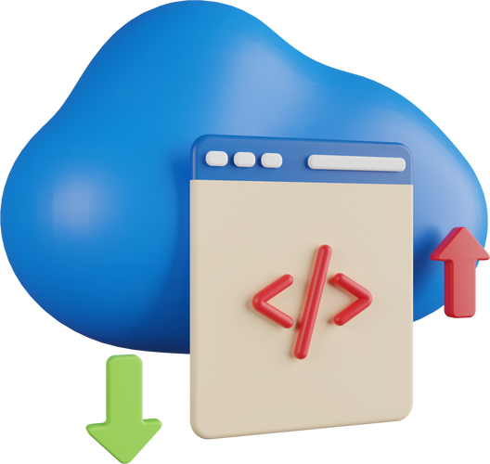
Introduction
In the rapidly evolving landscape of software development and embedded systems at STMicroelectronics, three key elements have emerged as pivotal in driving innovation and efficiency: GitHub, Python, and the STM32 firmware package.
So what are the specific features of GitHub, Python, and the STM32 firmware package, and how can these tools be combined to create an efficient software solution for extracting and organizing the exact files needed?

Slide 4

Environment :
Python & Github

Slide 5
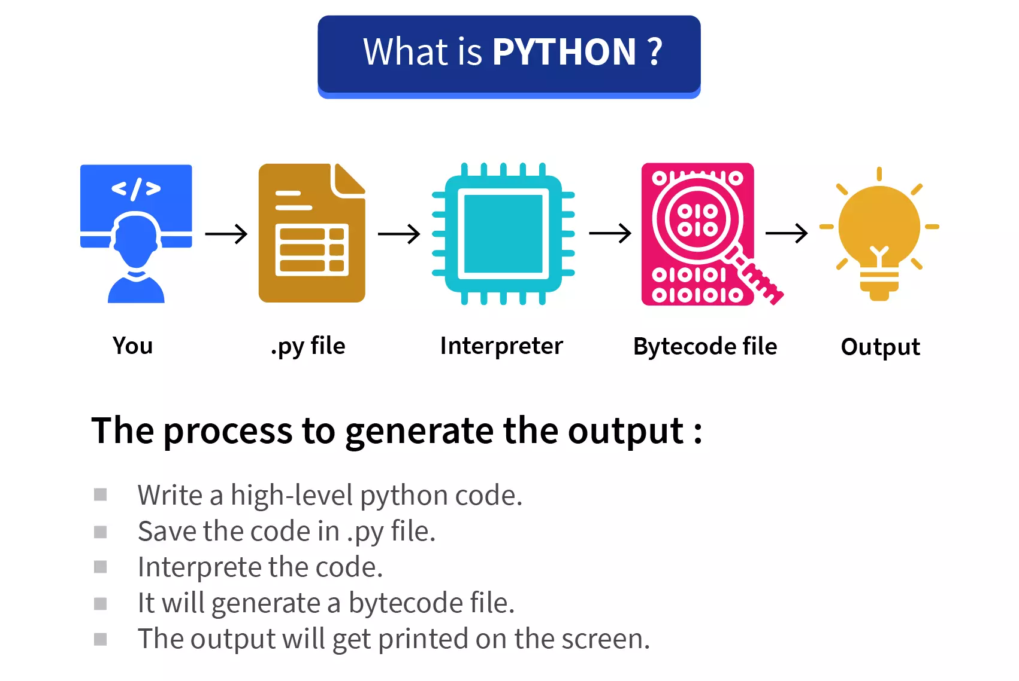
Python

Slide 6
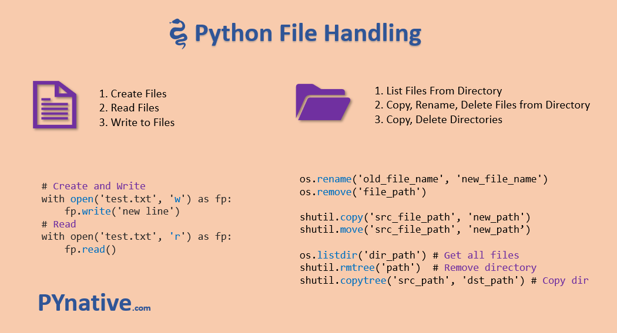

Slide 7

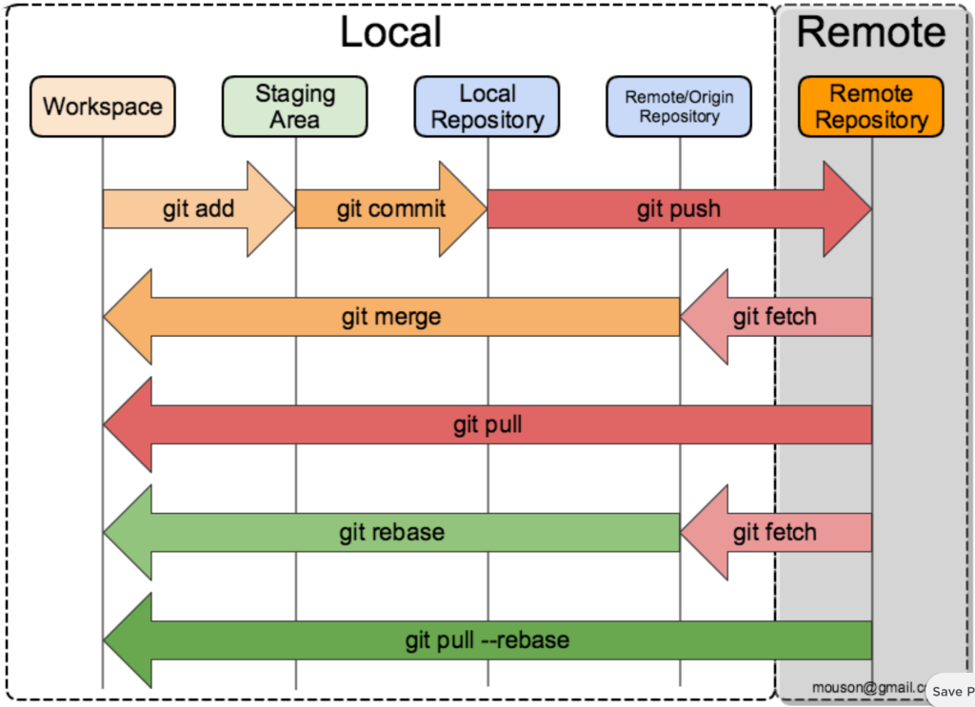
Working dir/workspace: Local file system
Staging area: Tracked files; prepare files to add to local repository
Local repository: Local version file control system
Remote repo: Public/Shared version file control system that local repos connect to.

Slide 8
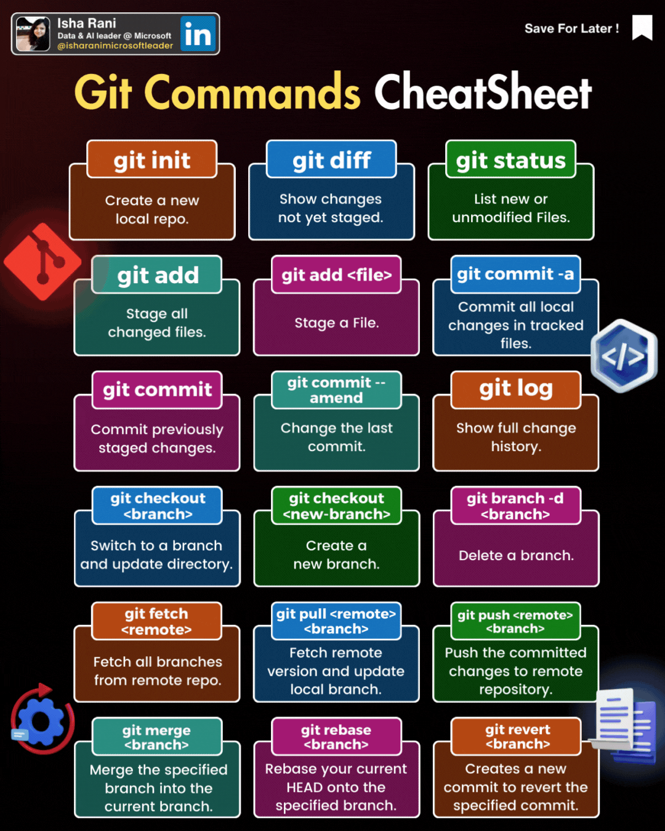

Slide 9


STM32 Cube2 Firmware package

Slide 10
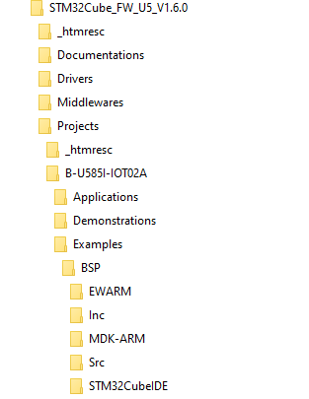
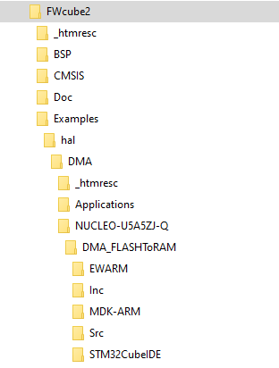
Boards classes drivers are no more provided.
➔Only parts drivers are provided.
➔Under the examples we find the card types where these examples are available
Cube1
Cube2

Slide 11

STM32 IDEs
IAR Embedded Workbench
STM32Cube MX2
STM32 Cube VS code
01
02
03
04
Email : Maher.etude@gmail.com

Slide 12

Online extractor
An online extractor is a web-based tool designed to extract specific data or files from various formats. These tools are commonly used for tasks such as extracting text from images, unzipping compressed files, or converting file formats.
➔These online extractors are essential for simplifying tasks such as data entry, document editing, and file management, making them valuable in various professional and personal contexts.

Slide 13
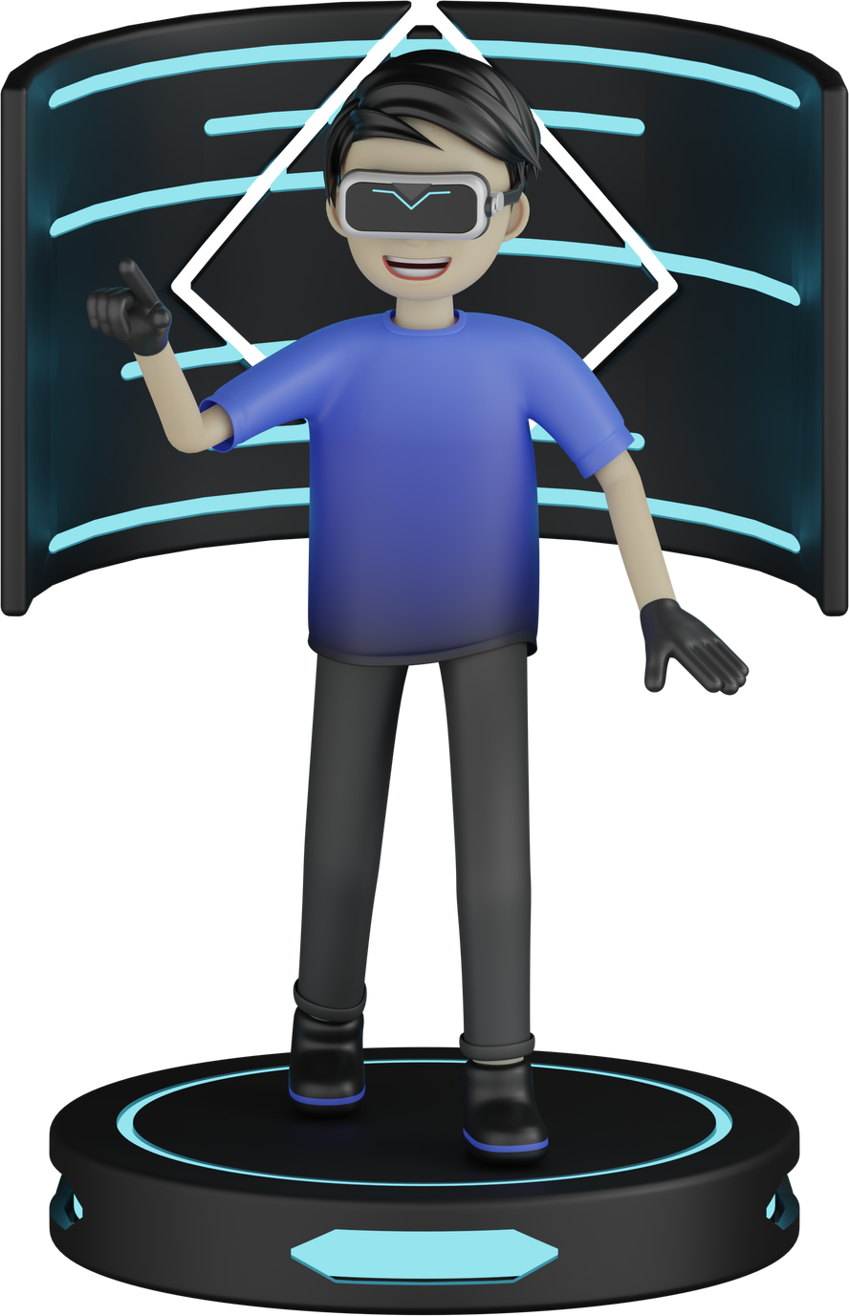
Project objective
Create a tool to extract a single sample project from a Github repository, the extraction should convert the project files to "under root" format so that they can be used directly in integrated development environments ( IDE) like IAR, CubeMX2 and STM32 Cube vs code.
01
02
03
04
Email : Maher.etude@gmail.com

